Slide 1




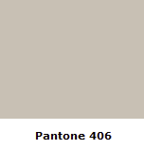

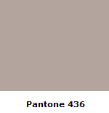
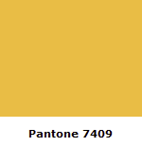
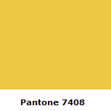
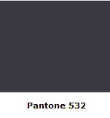
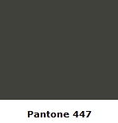
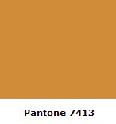


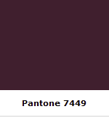




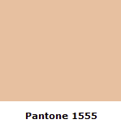
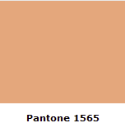

Slide 2







Slide 3

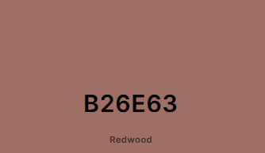
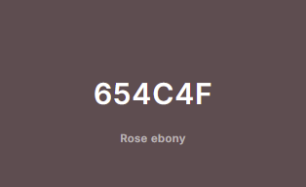
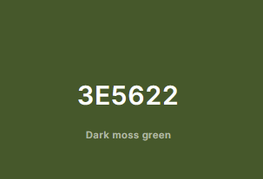

Slide 4

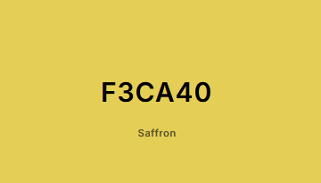
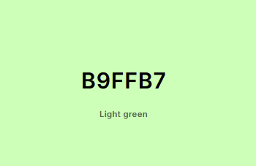
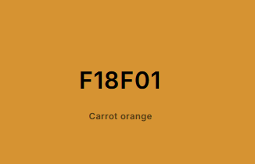
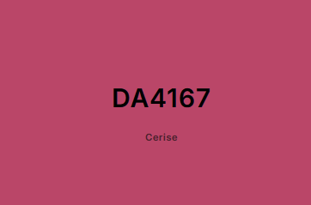
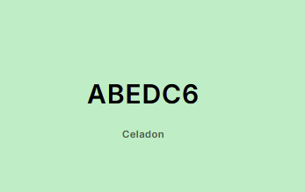
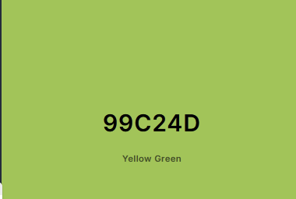


Slide 5
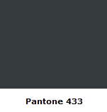





Slide 6


Slide 7


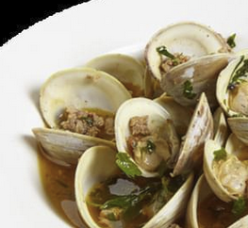
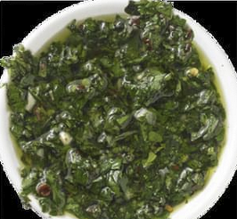
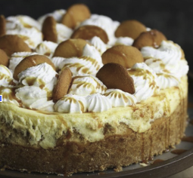

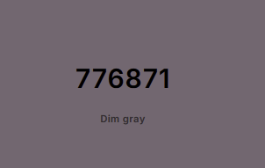

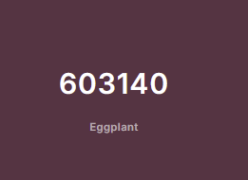
The Recipe Planner that works for you!
Search
Recipe
Home About Recipes Categories Planner
Color to use when Links are highlighted/ selected
Filter
Clamps in Chorizo Broth
27 Min
Chimichurri
2 Hours 30 Min
Banana Pudding Cheesecake
7 Hours 15 Min

Slide 8
Search
Recipe
Home About Recipes Categories Planner
Color to use when Links are highlighted/ selected
Filter
Clamps in Chorizo Broth
27 Min
Chimichurri
2 Hours 30 Min
Banana Pudding Cheesecake
7 Hours 15 Min

Slide 9

Search: What are you hungry for?
Recipe
Home About Recipes Categories Planner
Filter
Clamps in Chorizo Broth
27 Min
Chimichurri
2 Hours 30 Min
Banana Pudding Cheesecake
7 Hours 15 Min

Slide 10



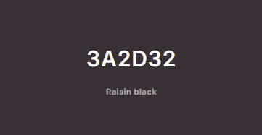

Recipe
Recipe
Home About Recipes Categories Planner
Filter
Clamps in Chorizo Broth
27 Min
Chimichurri
2 Hours 30 Min
Banana Pudding Cheesecake
7 Hours 15 Min

